Slide 1
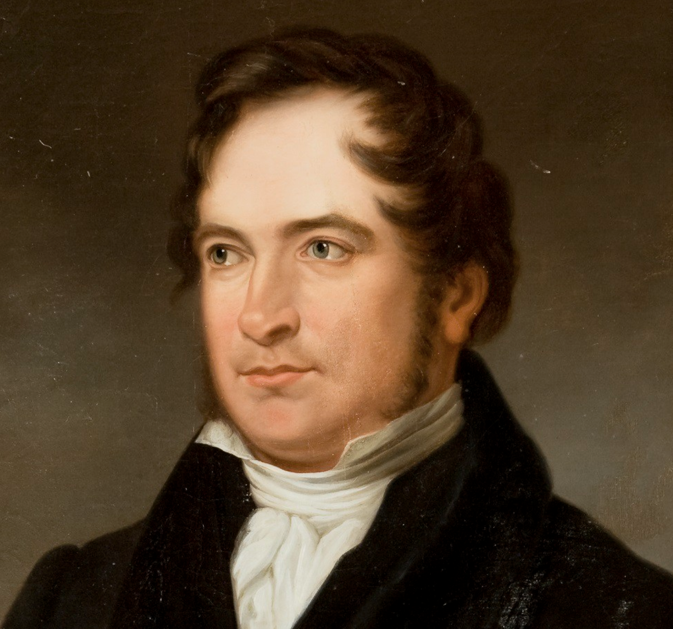
Geijer as Moral Philosopher
By Daniel Klein, econ prof and JIN chair at Mercatus,
George Mason University & Ratio Institute, Stockholm

Slide 2
In Adam Smith’s day
Natural philosophy –study of nature independent of man: Newton, Linnaeus
Moral philosophy – study of human conduct: History, morals, politics, linguistics, jurisprudence, economics, etc.

Slide 3
Aesthetics vs. grammar

Slide 4
Type of rules | “precise and accurate” | “loose, vague, and indeterminate”
Types of expression | literal | figurative

Slide 5
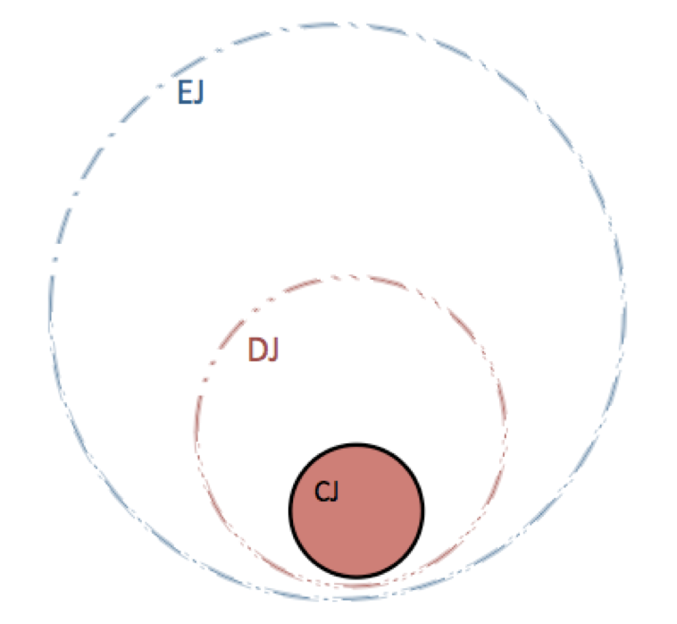
CJ in DJ in EJ

Slide 6
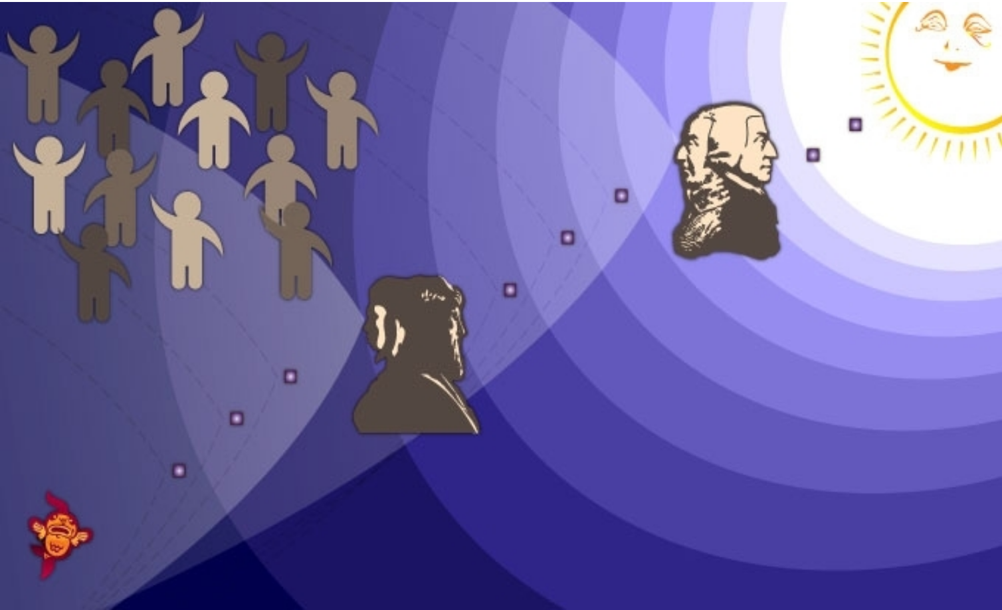

Slide 7
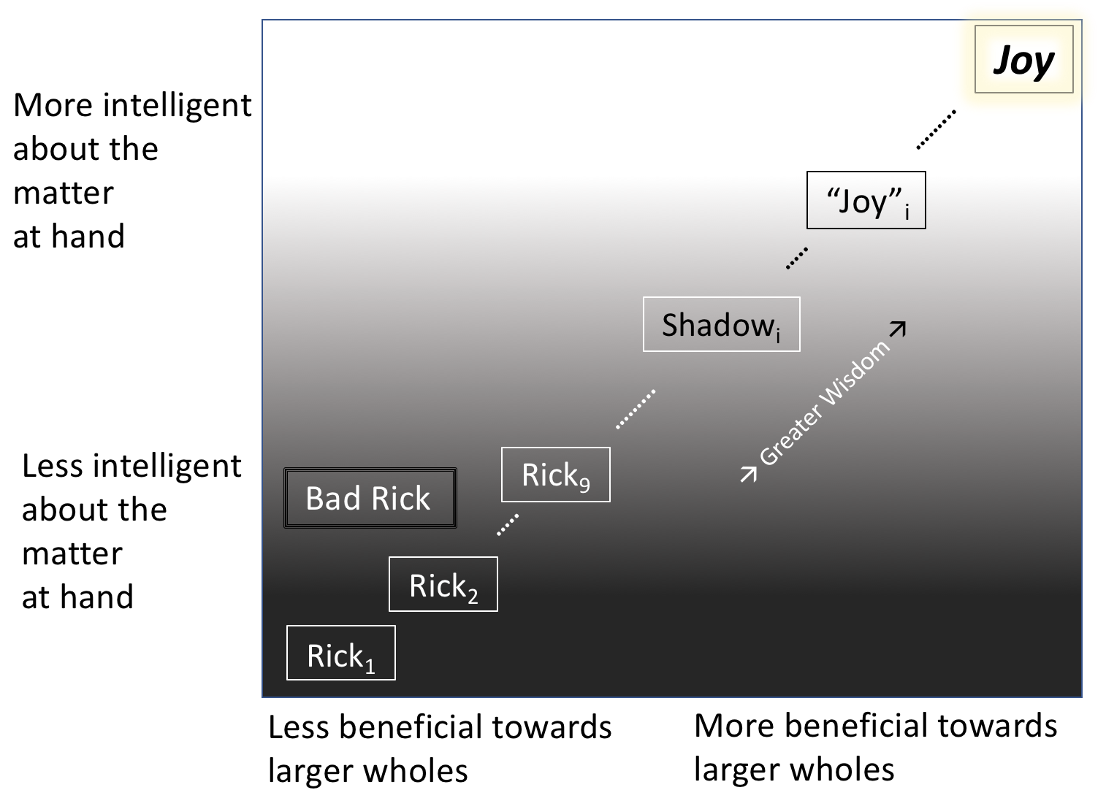

Slide 8
JGA Pocock
The 18C:
“The effect was to construct a liberalism which made the state’s authority guarantee the liberty of the individual’s social behavior, but had no intention whatever of impoverishing that behavior by confining it to the rigorous assertion of ego-centered individual rights. … A commercial humanism had been not unsuccessfully constructed….”

Slide 9
Critics of Smith’s TMS
Scotland: Henry Home Lord Kames, Thomas Reid, Adam Ferguson, Dugald Stewart, Thomas Brown, James Macintosh, Henry Brougham
England: Alexander Bain, J.S. Mill, H.T. Buckle, Leslie Stephens, Walter Bagehot, James A. Farrer, Harold Laski
France: Theodore Jouffroy
USA: Richard T. Ely

Slide 10
Criticisms
Opposed allegory or metaphor: (impartial spectator, man within the breast, invisible hand).
Smith was loose, vague, and circular.
Smith lacked “foundations.”

Slide 11
After Hume, Smith, Burke
Turn against allegory (and God)
Turn against historical dimension within theory
Image of social science: Precise and accurate rules of method; exact laws (“deduction”)
Turn toward separation of science and moral judgment/aesthetics (“value judgments”)
Turn toward separate disciplines, separate sciences
Later: Allegiance to idea of a “progressive research program”

Slide 12
After Hume, Smith, Burke
Rise of demarcationism, distinctions like “positive vs. normative”
Pretensions of expertise
From wisdom to logic/information/fact/reason
Foundationalism
Turn against and forgetting of esotericism (Melzer vii, 96)

Slide 13
Alas…
In those ways liberalism lent itself to being caricatured.

Slide 14
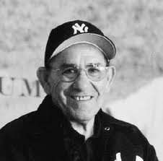
Yogi Berra
“If you don’t know where you’re going, you could end up somewhere else.”

Slide 15
The caricaturing of liberalism
Forsakes high things for low things, forsakes virtue
Prizes rights and liberty but disregards responsibilities
Materialistic, ego-centric, selfish, “possessive,” economistic
Atomistic (not only jurisprudentially, but also ethically)

Slide 16
Soap Operas Uber Alles
Romanticism vs. The Enlightenment (Reason)
Feeling vs. rationality, calculation, efficiency
Art vs. science
Society/community vs. the individual
Gemeinschaft vs. gesellschaft
Today: Humanity vs. neoliberalism

Slide 17
JGA Pocock
The 18C:
“The effect was to construct a liberalism which made the state’s authority guarantee the liberty of the individual’s social behavior, but had no intention whatever of impoverishing that behavior by confining it to the rigorous assertion of ego-centered individual rights. … A commercial humanism had been not unsuccessfully constructed….”

Slide 18
JGA Pocock
But then:
“About 1789, a wedge was driven through this burgeoning universe, and rather suddenly we begin to hear denunciations of commerce as founded upon soullessly rational calculation and the cold, mechanical philosophy…” (1985, 50)

Slide 19
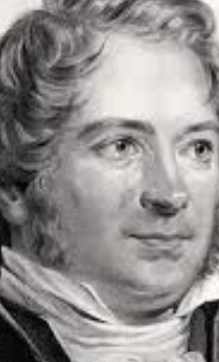
GEIJER OVERCOMES THAT WEDGE!

Slide 20
Geijer
Allegorical (and religious)
History integrated into morals and politics
Openness about own sense and sensibility, the voice of a friend, an avuncular voice
Integrates social sciences: MORAL PHILOSOPHY
Ethics pervades his discourse
Sensitive to paradoxes, dilemmas, contrarieties
Esoteric

Slide 21
“An Economic Dream”
1847
“This liberty is tantamount with disorder, a thousand voices shout. On the contrary, she is a new, self-evolving order; so do others comfort themselves, the more industrious, the wiser. That liberty, even if she brings disorder for a passing while, follows her own rules and develops from within, implanted in her by the Creator, her own law: that is the full faith of liberalism and it leads to salvation.” (p. 443)

Slide 22
“What is the new order of things? With each day, its law evolves more clearly; its substance is already so apparent that one can thereof judge its nature and the spirit of progress. This substance is the day-by-day, constantly evolving, all-encompassing fellowship and interaction of human powers and needs. This new, but actually ancient law of labour is that of intelligence, which works in expanding circles. From there comes the dependency, from there the interaction in all occupations, equally familiar and acknowledged, and which, to the extent of this increasingly ardent acknowledgement, communicates ever more directly with its own essence and from this[,] new, greater powers emerge, day-by-day and without surcease. Therefore, every seeming defeat is a true victory for it. It needs hardly touch the earth to feel at home and rise again with renewed vigour.”

Slide 23
“One needs only to regard this immortal principle in detail in its effects to find oneself in the field of an infinite project that reaches in all directions and returns from all directions to its centre. — How could any occupation, any area of human enterprise, now be able to isolate itself? In so doing, it cuts itself off from its very breath of life, withers and inevitably dies. It thrives, flourishes, feels happy and promotes happiness utterly to the same extent that it both communicates and receives based on an enlivening influence.
And so, the separated groups of industries and trades finally flowed together before my eye. The artisan, not merely with his bodily strength, but with his intelligence, was the foundation of it all, for an enterprise that the factory owner used and distributed, that the merchant spread across the earth. I saw a new day ascend above it. It was the rising sun; and the Dancing Hours moving around the sun, in measured heavenly-harmonious orbits, were the beautiful performance at which I wakened from my dream.” (pp. 444–446)

Slide 24
Hayek’s “communication” talk
“We must look at the price system as such a mechanism for communicating information if we want to understand its real function” (1948, 85-87).
Likewise, cooperation.

Slide 25
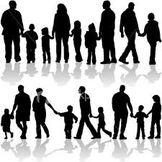
Allegory can help to answer in a liberal way the yearning for larger meaning and connection.
Allegory can help people to see that they must subdue or rechannel the yearning for larger meaning and connection.

Slide 26
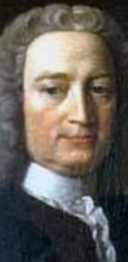
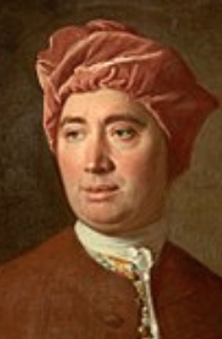
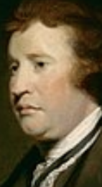
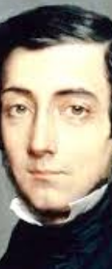
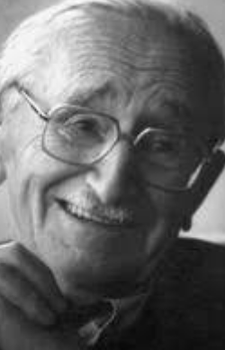
Moral philosophers
Smith
Hutcheson
Geijer
Hayek
Hume
Burke
Tocqueville
McCloskey

Slide 27
Ngram 1750-2008

Slide 28
Thank you for
your attention!

